Slide 1
PDF annotation tool

Slide 2
Requirement
Layoutlmft environment:
+ pip install pynput
Brew install libffi
Then For compilers to find libffi you may need to set:
export LDFLAGS="-L/usr/local/opt/libffi/lib"
export CPPFLAGS="-I/usr/local/opt/libffi/include”
then run
$ cp /usr/local/opt/libffi/lib/libffi.8.dylib /Users/data/opt/anaconda3/envs/layoutlmft/lib/
Place pdf directory, draw_bbox.py , pdf_process.py in the same folder

Slide 3
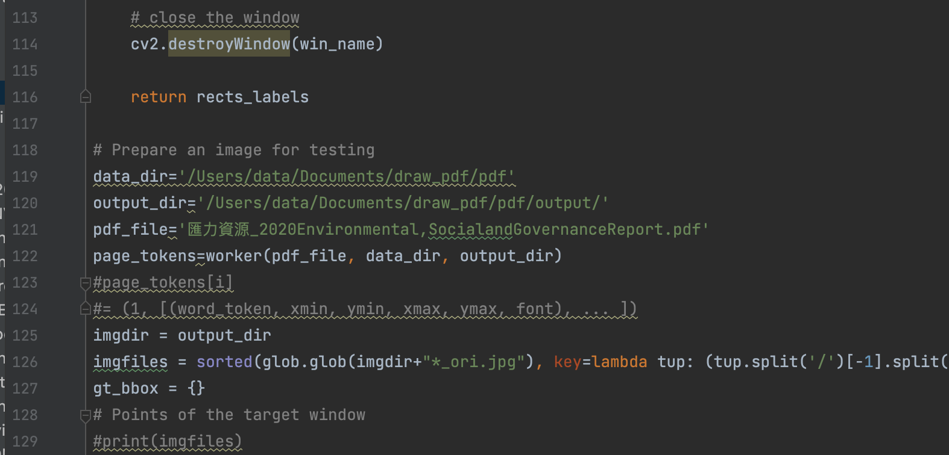
Input dir and file
Run draw_bbox.py to start
Now only accept 1 file per run

Slide 4
After running
Pdf file will be processed -> generate jpg at output dir
After generating all jpg files, window of report page pops up and can start labelling

Slide 5

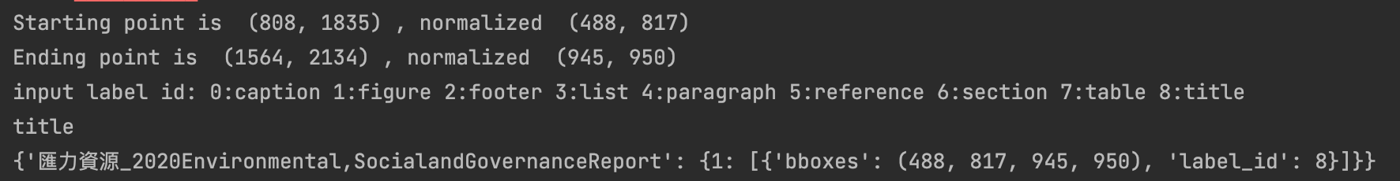
Labelling
Drag and Drop to determine bbox area -> press keyboard to input label_id
Press ‘c’ to continue to next page, press ‘r’ to replot
0:caption 1:figure 2:footer 3:list 4:paragraph 5:reference 6:section 7:table 8:title

Slide 6
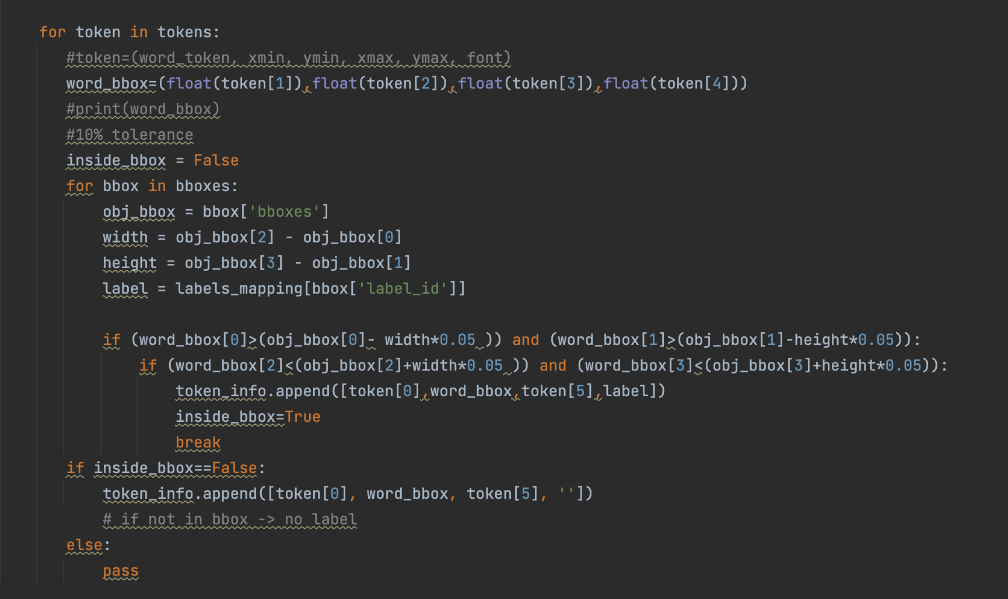
Matching
- Determine whether text tokens inside bbox
(with 10% tolerance)
- If not inside any bbox, label will be empty string

Slide 7
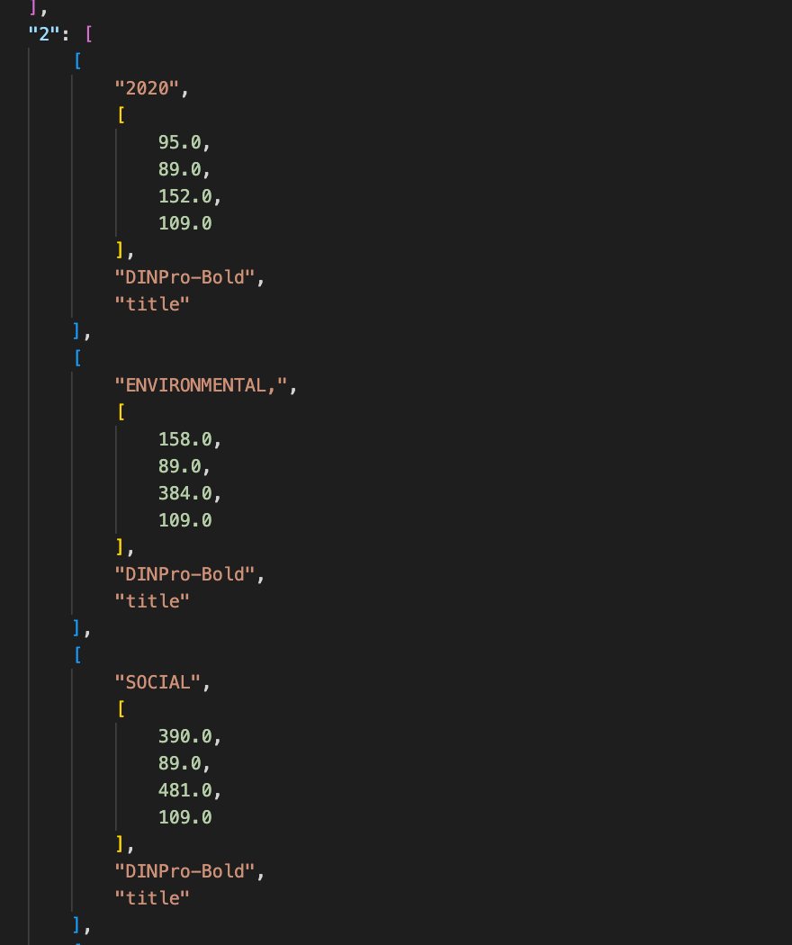
Output
Output in a json file in directory ‘token_label’
Output Structure Example

